Slide 1




Learning PlayWright (Java)
E2E Web Testing with Playwright(Java)
Pramod Dutta
SDET Manager
Page Object model with Playwright

Slide 2
Agenda
Revise the POM
Create a Structure of POM

Slide 3
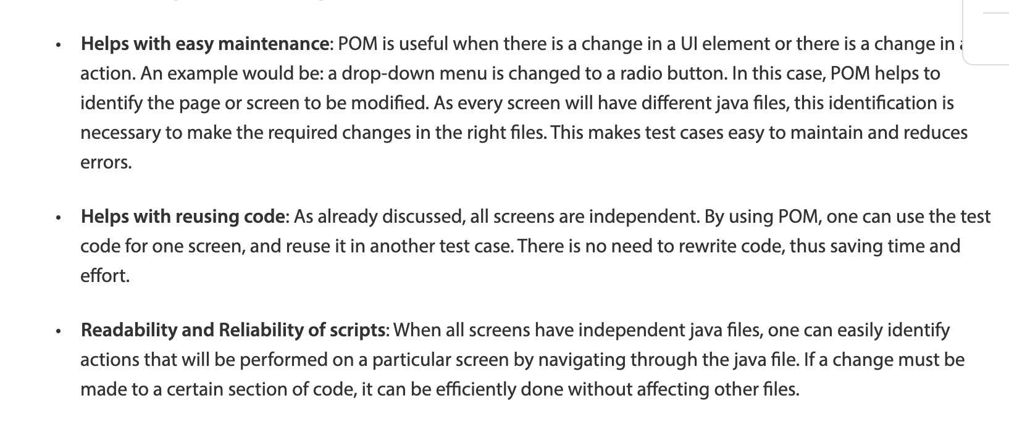
Page Object model
design pattern
https://www.browserstack.com/guide/page-object-model-in-selenium

Slide 4
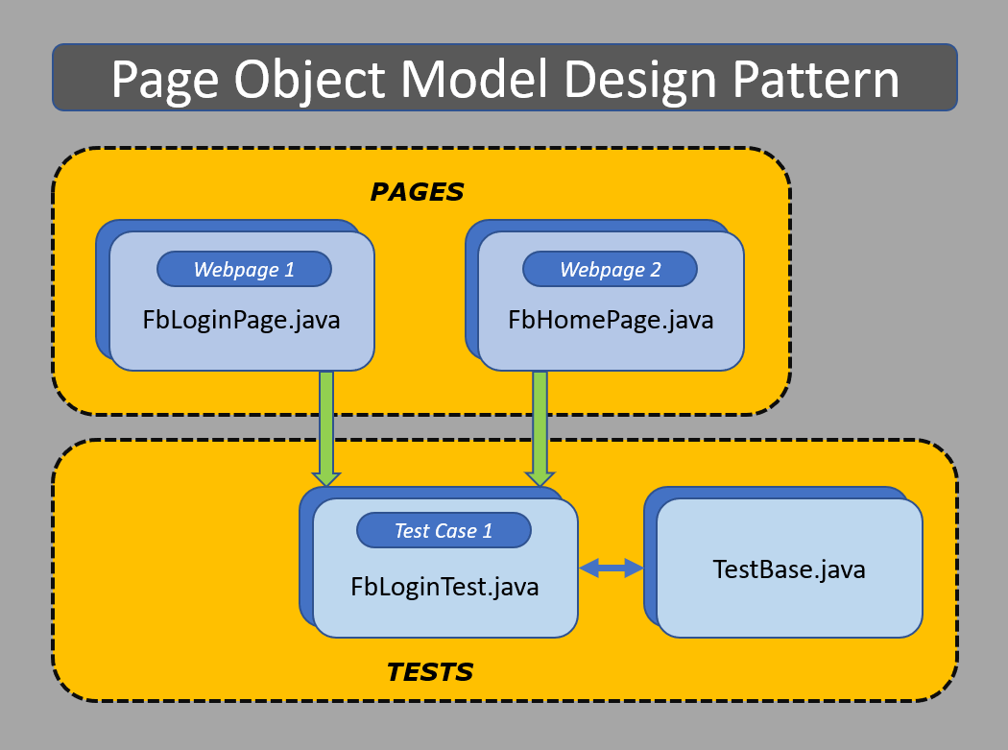
Page Object model

Slide 5
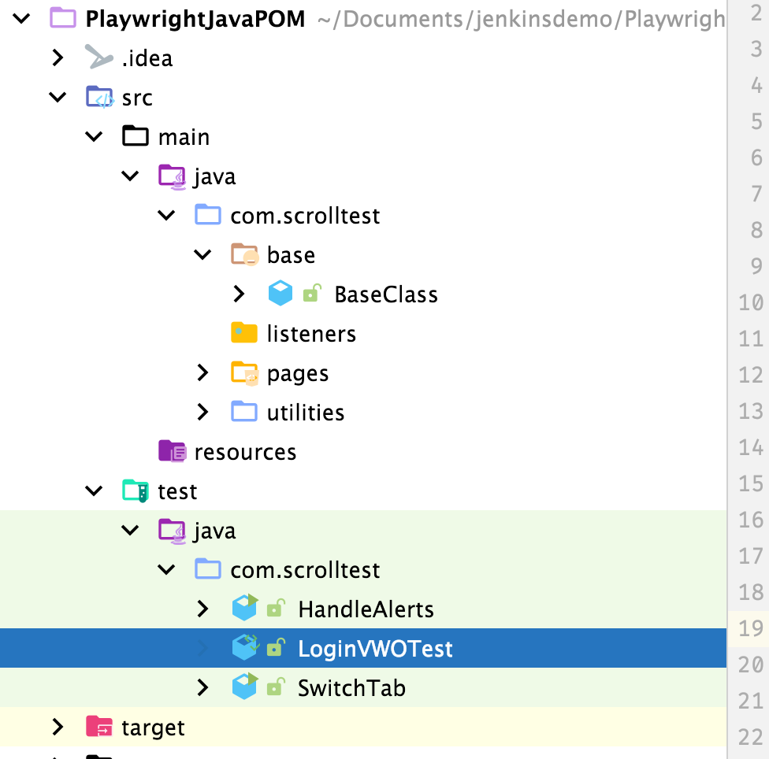
POM Folder structure

Slide 6
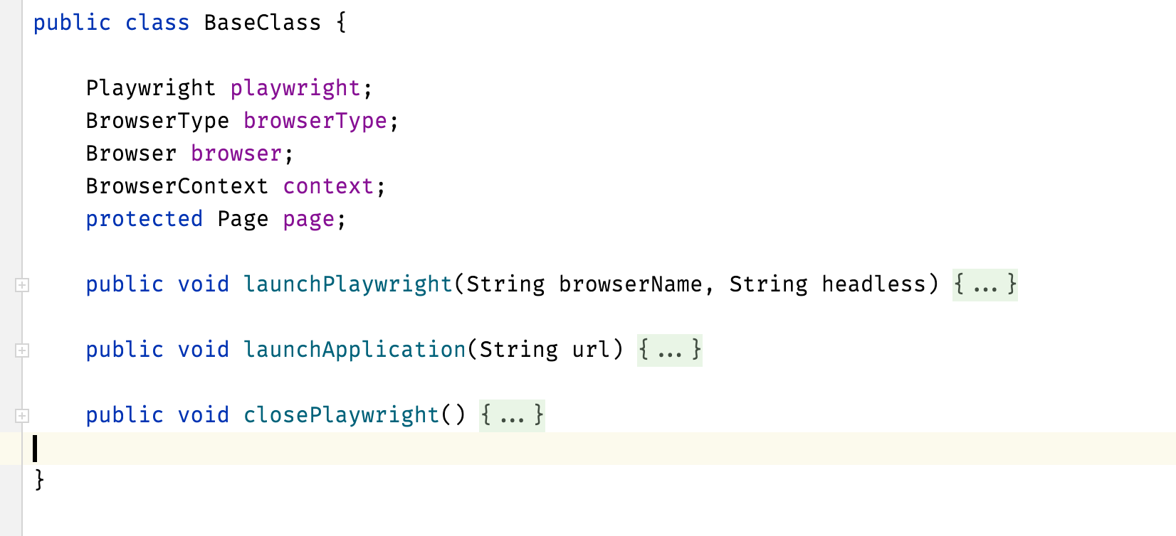
Base Class

Slide 7
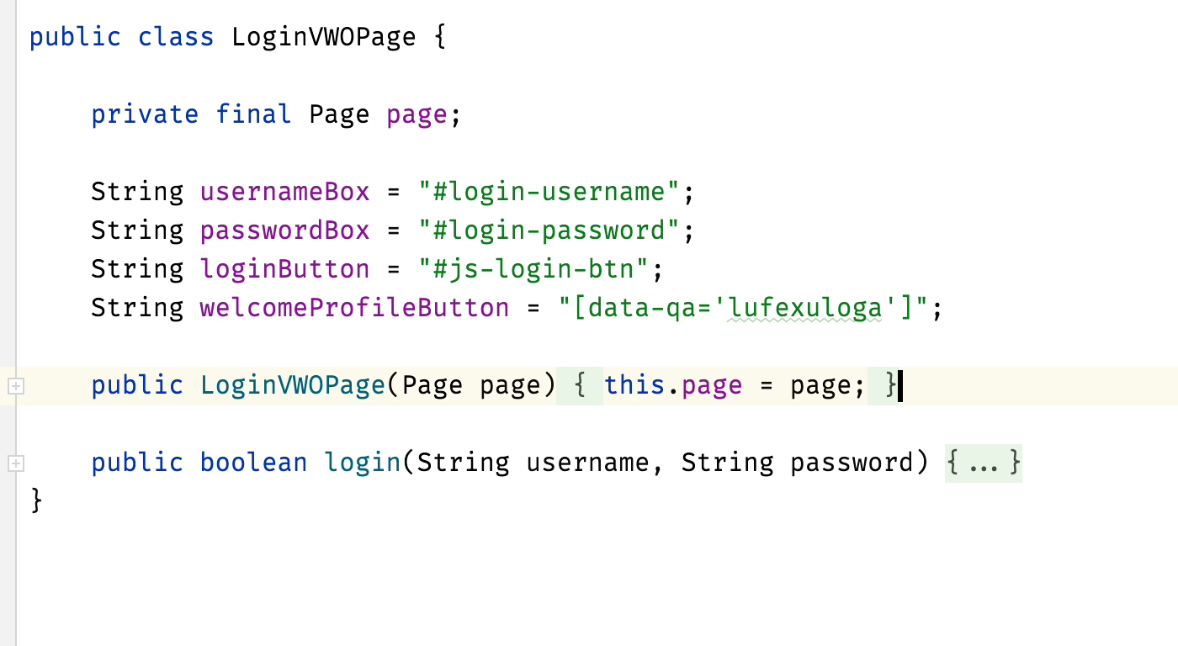
Page Class

Slide 8
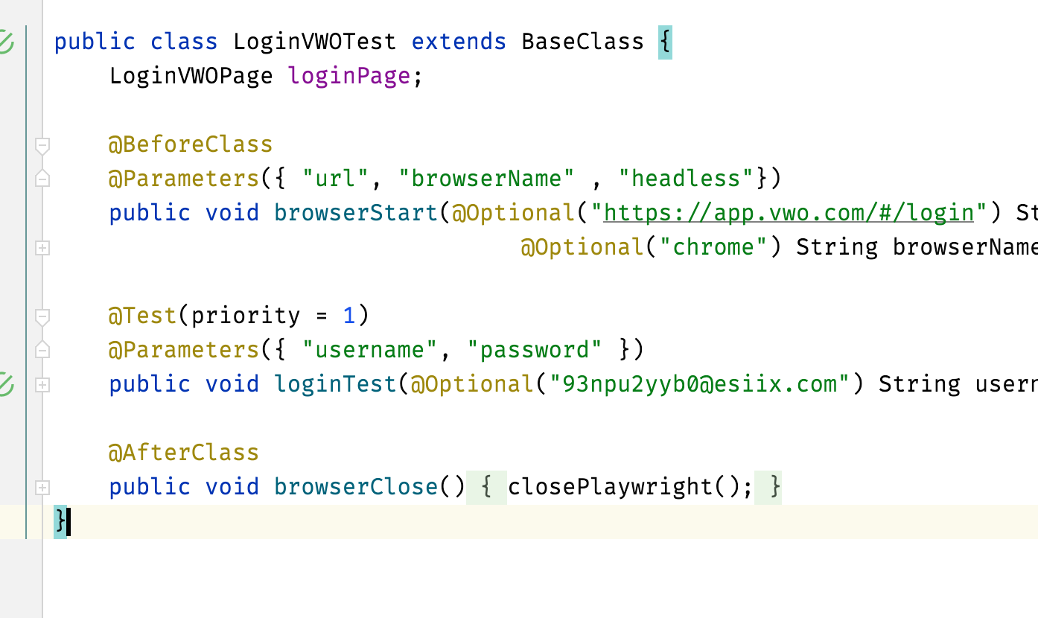
Page Test Class

Slide 9
Playwright Demo.

